Slide 1
Nested Class and It’s types

Slide 2
Under the umbrella of nested classes, there are two main types:
Static Nested Class: A static class inside another class.
Inner Class: A non-static nested class tied to an instance of the enclosing class.

Slide 3
Inner Class
In Java, inner class refers to the class that is declared inside class.
Inner classes in Java are a powerful feature that allows a class to be defined within another class.
They help logically group classes and enhance encapsulation, making the code more readable and maintainable.
There are certain advantages associated with inner classes are as follows:
Making code clean and readable.
Private methods of the outer class can be accessed, so bringing a new dimension and making it closer to the real world.

Slide 4
Inner Class vs Nested Class
A class inside a class said to be inner class or nester inner class?
A class inside a class is called a nested class. If it is non-static, it is specifically referred to as an inner class.
What’s the inner class?
An inner class is a non-static nested class. It is associated with an instance of the outer class and can access the outer class's non-static members and methods directly.

Slide 5
Types of Inner Classes
Nested classes are divided into two categories: static and non-static.
There are basically four types of inner classes in java.
Nested Inner Class (a.k.a Non-static)
A class inside a class is called a nested class
Non-static nested classes are called inner classes.
Method Local Inner Classes
Static Nested Classes
Nested classes that are declared static are simply called static nested classes.
Anonymous Inner Classes

Slide 6
Nested Inner Class
A nested inner class is defined inside another class and behaves like a regular member of that class.
It can access all members (including private members) of the outer class.
Key Points:
Must be instantiated using an object of the outer class.
Cannot have static members.

Slide 7
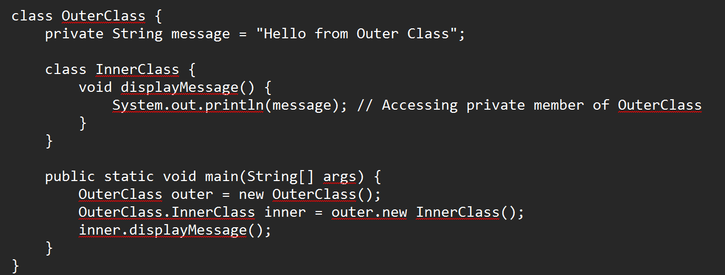
Nested Inner Class

Slide 8
Nested Inner Class
It can access any private instance variable of the outer class.
class Outer_Demo {
private int num = 175;
public class Inner_Demo {
public int getNum() {
System.out.println("This is the getnum method of the inner class");
return num; } } }}

Slide 9
Nested Inner Class
It can access any private instance variable of the outer class.
public class Main{
public static void main(String args[]) {
// Instantiating the outer class
Outer_Demo outer = new Outer_Demo();
// Instantiating the inner class
Outer_Demo.Inner_Demo inner = outer.new Inner_Demo();
System.out.println(inner.getNum()); } }
Outer.Inner in = new Outer().new Inner();

Slide 10
Method-local Inner Class
A class defined within a method is called a method-local inner class.
It is only accessible within the scope of the method in which it is defined.
Key Points:
Can access local variables of the method, but only if they are final or effectively final (unchanged after initialization).

Slide 11
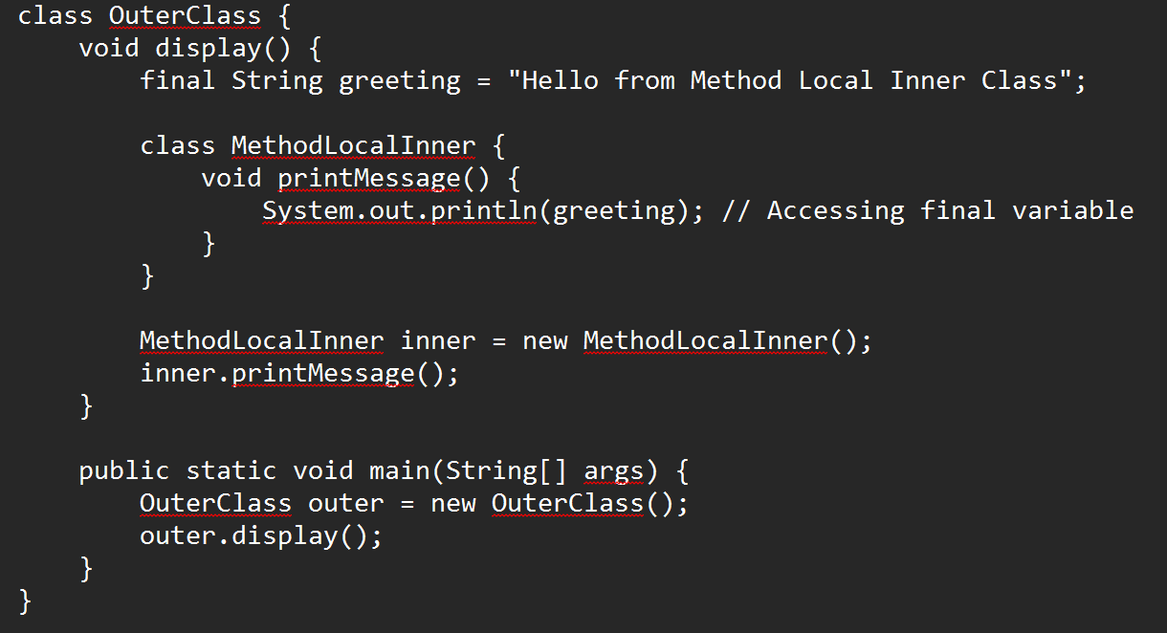
Method-local Inner Class

Slide 12
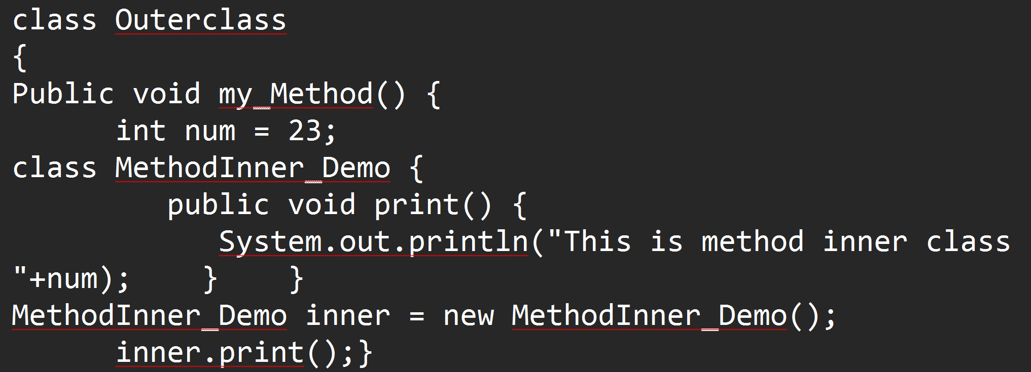
Method-local Inner Class
In Java, we can write a class within a method and this will be a local type. Like local variables, the scope of the inner class is restricted within the method.

Slide 13
Method-local Inner Class
public static void main(String args[])
{
Outerclass outer = new Outerclass();
outer.my_Method();
}
}

Slide 14
Static Nested Class
A static nested class is defined with the static keyword.
Unlike other inner classes, it does not require an instance of the outer class to be instantiated.
It can only access static members of the outer class.

Slide 15
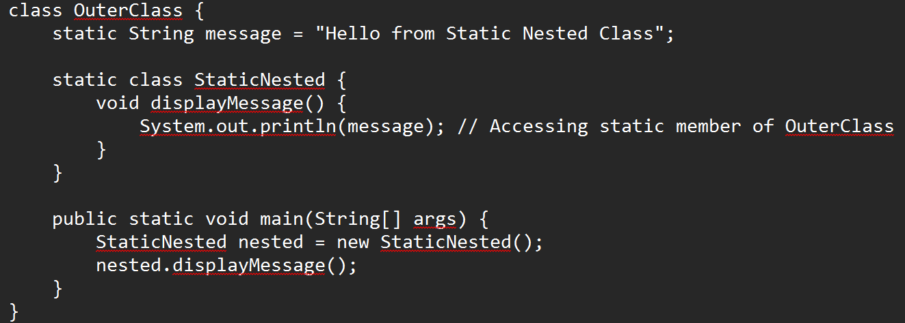
Static Nested Class

Slide 16
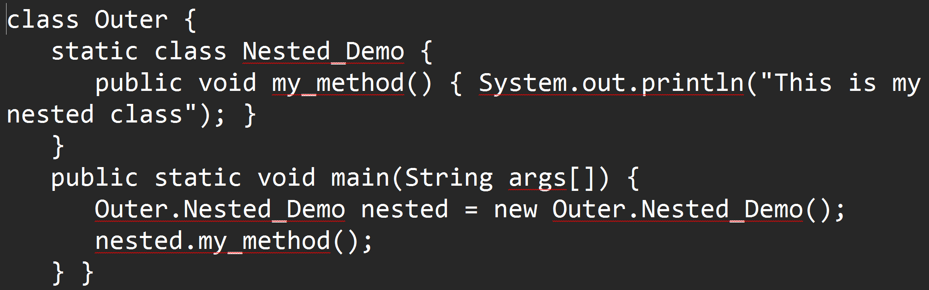
Static Nested Class
public class Outer {
static class Nested_Demo {
public void my_method() { System.out.println("This is my nested class"); }
}
public static void main(String args[]) {
Outer.Nested_Demo nested = new Outer.Nested_Demo();
nested.my_method();
} }

Slide 17
Anonymous Inner Class
An anonymous inner class is a class without a name and is instantiated on the fly. USE WHEN IT IS NEEDED ONLY ONE TIME
It is often used when a class is needed for a single-use, typically when implementing interfaces or extending a class.

Slide 18
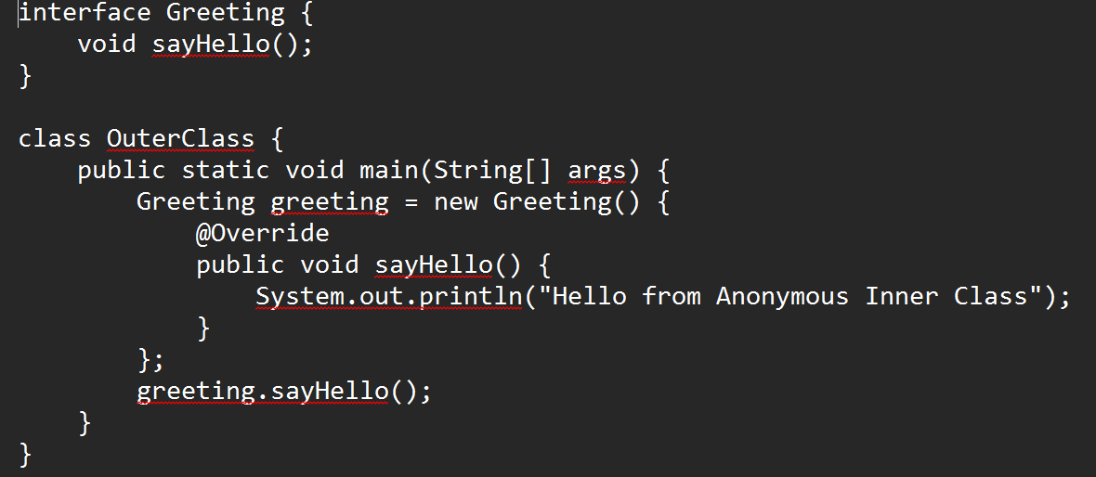
Anonymous Inner Class

Slide 19
Anonymous Inner Class
abstract class AnonymousInner { public abstract void mymethod(); }
public class Outer_class { public static void main(String args[]) {
AnonymousInner inner = new AnonymousInner() {
public void mymethod() { System.out.println("This is an example of anonymous inner class"); }
};
inner.mymethod(); } }

Slide 20
Anonymous Inner Class as Argument
interface Message { String greet(); }
public class My_class {
public void displayMessage(Message m) {
System.out.println(m.greet() + ", This is an example of anonymous inner class as an argument"); }
public static void main(String args[]) {
My_class obj = new My_class();
obj.displayMessage(new Message() {
public String greet() {
return "Hello"; } }); }}

Slide 21

